Slide 1
Prepared By
Created
Design Team
29/01/2021
CORPORATE BUSINESS PRESENTATION TEMPLATE 2021
Business
Review 2023

Slide 2
Customer
Experience

Slide 3
Team Dynamic
Overview of Team Dynamics 2023
Current Count
33 Emp
New Additions in 2023
10 Emp
Employee Turnover
17 Emp
Involuntary Separation
4
Net Total of Employees
50

Slide 4
Departmental
S.W.O.T Analysis
Strength
Weakness
Team rotation
Updating shops
fresh hires
Customer Turnover
S
W
O
T
Opportunities
Threat
Onboarding
Training
Implementing Sales System for POS
NassWallet Agent Account implementation
Economic Downturn
Currency Fluctuations

Slide 5
S.W.O.T Analysis
S
Team rotation
Team rotation in the context of customer service refers to the practice of systematically assigning employees to different roles or responsibilities within the customer service team. This strategy involves periodically rotating individuals among various tasks, such as handling inquiries, managing complaints, or providing support through different channels. The aim is to enhance overall team flexibility, skill development, and efficiency, as team members gain a more comprehensive understanding of the entire customer service process through exposure to diverse roles. This approach often contributes to a well-rounded and adaptable customer service team, capable of addressing a variety of customer needs effectively.

Slide 6
S.W.O.T Analysis
1. Lack of Updates on New RIGT Products:
W
The customer service team faces a weakness in not being sufficiently updated about the latest products offered by RIGT Company. This gap in product knowledge can hinder the team's ability to provide accurate and timely information to customers, impacting customer satisfaction and potentially leading to missed opportunities for upselling or cross-selling. To address this, a comprehensive training program or regular updates on new product releases should be implemented to ensure that the customer service team stays well-informed and can effectively assist customers with inquiries related to the latest offerings
2. High Proportion of Fresh Hires:
The team's reliance on a significant number of fresh hires may pose a challenge in terms of experience and expertise. While new talent brings enthusiasm and a fresh perspective, there might be a learning curve for these individuals in understanding the intricacies of the company's products, services, and customer handling processes. This could potentially result in longer resolution times and a higher likelihood of errors. To mitigate this weakness, a mentorship or buddy system can be established to pair new hires with more experienced team members, facilitating knowledge transfer and accelerating the onboarding process. Additionally, ongoing training programs and continuous feedback mechanisms can be implemented to expedite the development of skills and knowledge among the newer members of the team.

Slide 7
S.W.O.T Analysis
O
Onboarding.
Collaborate with the HR team to create a detailed onboarding schedule that outlines the various stages and activities for each new employee.
Ensure all necessary paperwork, documents, and access credentials are prepared and organized for easy distribution.
Double-check that the onboarding materials and resources are readily available for use.
Implementing Sales System for POS
In today's dynamic business environment, the ability to provide seamless and efficient transactions is crucial. I propose the implementation of a modern sales system for our POS terminals, and I recommend adopting FINEX Systems. This platform offers a range of benefits that align perfectly with our goals:

Slide 8
S.W.O.T Analysis
T
Economic Downturn
.
Threat: Economic uncertainties leading to reduced consumer spending on discretionary items like fintech products.
Impact: Decline in sales, lower revenue, and potential financial strain on the business.
Currency Fluctuations:
Threat: Volatility in currency exchange rates affecting the cost of imported fintech products.
Impact: Fluctuating profit margins and the need for effective currency risk management strategies.
.

Slide 9
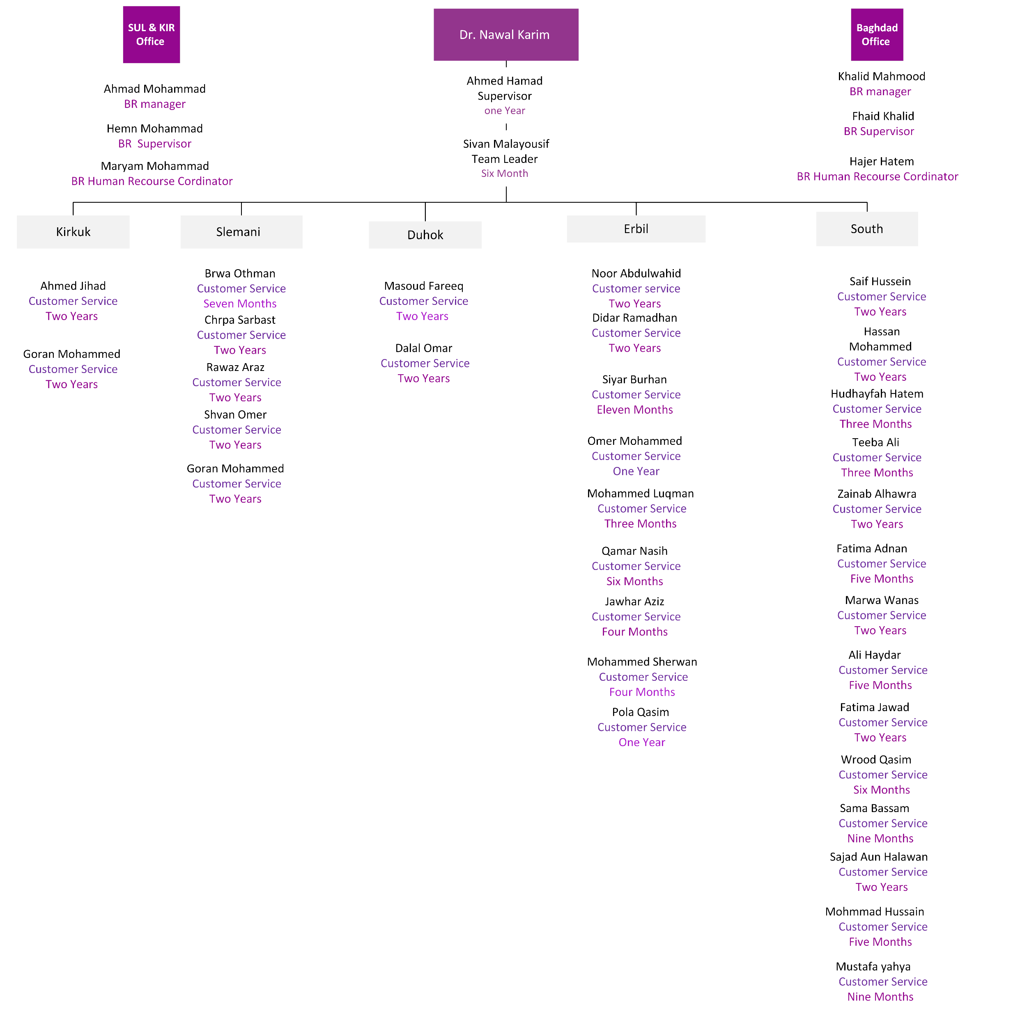
Team Structure

Slide 10
Key Achievements
Many things we can do to realize your future needs. From studying business to managing assets and investing.
01.
New Shops Opining
04.
Data Entry Task
One significant achievement is the successful launch of five new shops spanning diverse locations and cities.
Utilizing the available downtime within the retail establishment to allocate Data Entry tasks, thereby leveraging the idle time of the shops for productive purposes.
02.
05.
Training
Team Rotation
Two training programs have been concluded, covering soft skills in one and specifically addressing Western Union (WU) in the other.
team rotation stands as a key achievement in our department, promoting versatility, collaboration, and individual growth. This strategic endeavor has not only optimized our operational efficiency but has also positioned our team as a resilient and adaptive force in the pursuit of excellence.

Slide 11
Best Sales & DE Month
.
Notes:
Percentage Change=((Second Period Value−First Period Value)/​First Period Value)×100

Slide 12
Internal Challenges
Many things we can do to realize your future needs. From studying business to managing assets and investing.
03.
Challenge 3
insufficient support from Baghdad Office.
01.
Challenge 1
04.
Challenge 4
We are currently encountering a difficulty wherein a considerable number of customers are departing from our services as a result of the lack of new card issuance and renewals.
We are facing difficulties in onboarding new employees.
02.
Challenge 2
05.
Challenge 5
Another challenge we're encountering is the need to issue refunds on Card Houzz.
The customer service team faces a weakness in not being sufficiently updated about the latest products offered by RIGT Company.

Slide 13
2024
Plans and Objectives
Target And incentive
Individual Brilliance: Tailored individual sales targets for each employee, maximizing their unique strengths.
Shop Synergy: Collective shop sales targets that foster collaboration and shared success.
Product Enthusiasm: Monthly rotation of product focus to ensure well-rounded expertise.
Setting targets based on the stock of product.
NassWallet Agent Account implementation
Currently, we are solely relying on the HQ Jouhayna agent account for cash in-cash out operations, facilitated through WhatsApp communication. However, we believe that formalizing the process through NassWallet agent accounts will offer several advantages:
Efficiency, Formal Record Keeping, Security, Enhanced Customer Experience
Customer Feedback record- Feedback
This updated plan retains its emphasis on crucial monthly activities, highlighting the significant role of the HR team in establishing a strong customer feedback system throughout the year 2024.

Slide 14
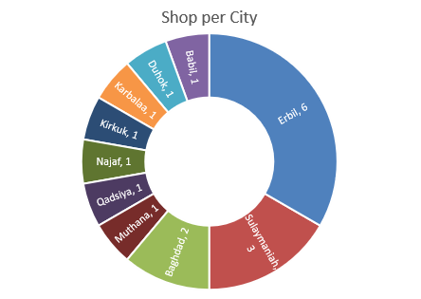
RIGT Shops coverage within Iraq
Duhok
Mosul
Erbil
Kirkuk
Sulaymaniyah
Salahaddin
Dyala
BGD
Anbar
Karbala
Babil
Waset
Qadsiya
Mesan
Najaf
Thiqar
Basra
Muthana

